Slide 1
Phase II Trial Design In Oncology
Wendy R. Parulekar MD FRCP
Senior Investigator
Canadian Cancer Trials Group
Queen’s University

Slide 2
Disclosures
Pfizer
Celgene
Hecht Foundation
CBCF
CIHR
AstraZeneca
TerSera
Roche
Novartis/AAA

Slide 3
Learning Objectives
To define the role of a phase II trial in oncology drug development
To describe the objectives and the statistical parameters that provide the framework of a phase II trial design
To illustrate different phase II trial designs using examples from the CCTG casebook

Slide 4
Phase II Trial
The phase II trial has a pivotal role in drug development since the major decision to proceed with further testing is usually based on phase II trial results.

Slide 5
Phase II Trial Screens for Efficacy
Primary goal
Identify and characterize the preliminary clinical efficacy of a new agent/ combination of agents/ schedule of administration
Secondary goals
Characterize adverse event profile
Understand mechanism of action
Further define target population for administration of agent

Slide 6
Phase II Trial Designs
Multiple designs available
Variations based on
specific stage of development of the therapeutic intervention
how the results will inform continued therapeutic development

Slide 7
Phase II Trial Designs
Defining design characteristics
Endpoints: primary and secondary
Single or two stage design (one versus two step enrollment per arm)
Single arm or multiple arm design
Statistical considerations: Type I (α) error rates and power (1-β) measures of anticancer activity (e.g. response rates, hazard ratio….)

Slide 8
A Sampling of Phase II Trial Designs

Slide 9
Standard Single Arm Phase II Trial
Comparison is “fixed” constant – historical control
Binary endpoint (e.g. clinical response vs. no response)
Defining characteristics
α = Type I error
Power: 1-β
H0: null response rate – not of interest
HA: target response rate – of interest
Based on design parameters sample size= N

Slide 10
HN.10
A Phase II Single Arm Trial of Elective Volume Adjusted De-Escalation Radiotherapy (EVADER) in Patients with Low-risk HPV-related Oropharyngeal Squamous Cell Carcinoma
(NCT 03822897)

Slide 11
Rationale
Low risk, HPV associated oropharyngeal squamous cell carcinoma
Curatively treated with radiotherapy
Long term treatment related morbidity is common
eg. swallowing and salivary gland function
Volume de escalation of radiotherapy fields may lessen burden of toxicity without a compromise in disease control

Slide 12
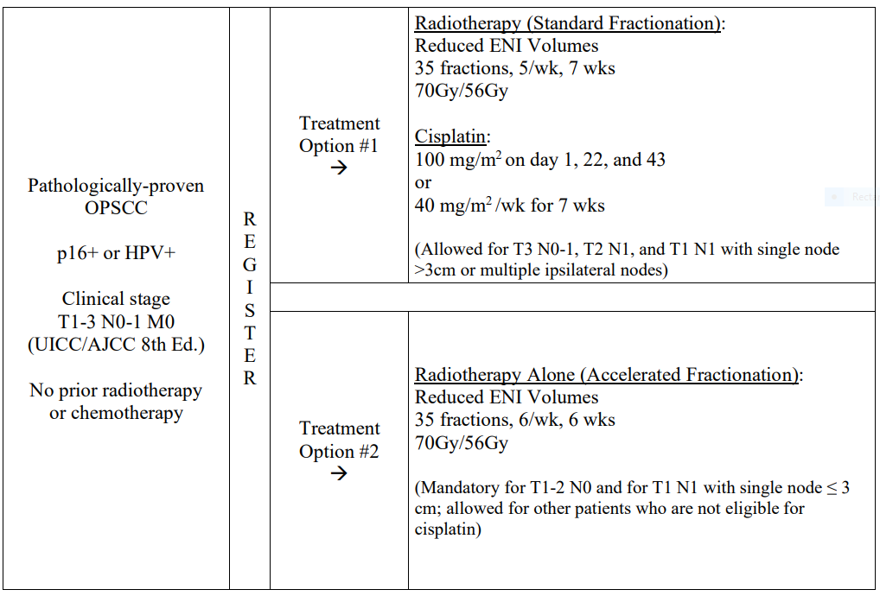
HN.10

Slide 13
HN.10 Endpoints
Primary
Two year event free survival
Secondary
Overall survival
Disease control (local, regional, local-regional, out-of-field regional)
Distant metastasis free survival
Early and late toxicities of treatment
Subjective swallowing functions
Quality of life (QOL)
Utilization of healthcare resources, work productivity
Prognostic biomarkers

Slide 14
HN.10 Statistical Parameters
2 year EFS: H0 < 85% HA =91%
Type 1 (α) error = 0.10; power (1- β) = 80%
Sample size 100; 304.7 person-years of follow-up required for the final analysis
Current Status: final analysis complete; LBA ASTRO 2024

Slide 15
Can we improve the efficiency of the single stage phase II trial design?

Slide 16
Two stage trial designs will limit exposure to inactive treatment strategies

Slide 17
IND.182 Buckstein et al., Leuk LymphoMA 2011
Sunitinib in relapsed or refractory diffuse large B-cell lymphoma: a
clinical and pharmacodynamic phase II multicenter study of the NCIC Clinical Trials Group
(NCT00392496)

Slide 18
Rationale
Relapsed or refractory diffuse large B cell lymphoma
25-30% cured with salvage chemotherapy and bone marrow transplant
VEGF pathway is important – implicated in progression
Sunitinib is an orally bioavailable inhibitor affecting receptor tyrosine kinases involved in tumor proliferation and angiogenesis (VEGFR-1, -2, -3, and PDGFR-a and –b)

Slide 19
IND.182
Relapsed/ refractory or transformed B cell lymphoma
R E
G
I
S
T
E
R
Sunitinib 37.5 mg po daily, q 4 weeks
Response

Slide 20
IND.182 Endpoints
Primary
Objective response using standard criteria for non-Hodgkin lymphoma
Secondary
Toxicity
Progression Free Survival (PFS)
Anti-angiogenic activity: circulating and apoptotic endothelial cells and precursors

Slide 21
IND.182 Statistical Parameters
H0 =5% HA =20%
Type 1 (α) error = 0.12 ; power (1- β) = 89%
Two stage:
Ist stage: enroll 15 patients – continue if at least one response
2nd stage: additional 10 patients
Sunitinib worthy of further study if at least 3 responses in 25 patients

Slide 22
IND.182 Results
Response Rate
First stage: 17 eligible patients, 15 evaluable for response
No responses seen – study stopped
No convincing pharmacodynamic evidence of antiangiogenic activity (CEC and CEP biomarker analysis)

Slide 23
IND.182 Conclusions
Sunitinib
Inactive in patients with relapsed or refractory diffuse large B cell lymphomas

Slide 24
Single Arm Phase II Trial Design Limitations
Challenging due to choice of historic control for estimation of H0
Biases in patient selection, earlier detection of disease states, differences in disease outcome assessment, improvements in supportive care may contribute to estimate of activity - independent of drug effect

Slide 25
Can we refine the design of the phase II trial?

Slide 26
Randomized phase II trial designs may address some of the limitations of the single arm trial: confounding, reliance on historic estimates of efficacy for H0, resource allocation constraints…

Slide 27
Randomized Phase II Trial Design
Randomization is a process and further details are needed to understand the goals and design of the trial

Slide 28
Randomized Phase II Trial Design:
Experimental Arm with Concurrent Control to Anchor Interpretation

Slide 29
IND.165 Chi et al, J Clin Oncol 2010
Docetaxel and Prednisone With or Without OGX-011 in Patients With Metastatic Castration-Resistant Prostate Cancer
(NCT00258388)

Slide 30
Rationale
Castration Resistant Prostate Cancer (CRPC)
Characterized by disease progression despite castrate state
Highly lethal despite chemotherapy sensitivity to docetaxel regimens
Clusterin is a cell survival protein which is induced by therapeutic stressors and is expressed in CRPC

Slide 31
OGX-011 in CRPC
OGX-011
Second generation antisense molecule that is complimentary to clusterin mRNA translation initiation site
Biologically effective dose 640 mg tested prior to prostatectomy
Well tolerated
> 90% inhibition of clusterin
Increased apoptosis
Phase I study demonstrated safety with docetaxel

Slide 32
IND.165
Metastatic prostate cancer with progression on androgen ablation
R A N DOM I Z E
Docetaxel 75 mg IV q 3 weekly
Prednisone 5 mg po bid
Efficacy
Docetaxel 75 mg IV q 3 weekly
Prednisone 5 mg po bid
OGX-011 640 mg IV loading dose then weekly
N= 40 per arm

Slide 33
IND.165 Endpoints
Primary
Proportion of patients with PSA decline > 50% from baseline
Secondary
Response Rate (RR)
Toxicity
Progression Free Survival (PFS)
Overall Survival (OS)
Changes in serum clusterin

Slide 34
IND.165 Statistical Parameters
Docetaxel + Prednisone + Clusterin arm
H0 < 40% HA >60%,
Type 1 error = 10% (1 sided); power = 90%
20 or more PSA responses in 40 enrolled patients

Slide 35
IND.165 PSA Response
Docetaxel + Prednisone + OGX 011:
58% (90% CI 43.3-70.8)
Docetaxel + Prednisone:
54% (90% CI 39.8-67.1)

Slide 36
IND.165 Endpoints
Secondary Endpoint | Docetaxel + Prednisone + OGX 011 | Docetaxel + Prednisone
RR (95% CI) | 19% (95% CI 6.6-39.4) | 25% (95% CI 9.8-46.7)
Median PFS (95% CI) | 7.3 months (95% CI 5.3-8.8) | 6.1 months (95% CI 3.7-8.7)
Median Overall Survival (95% CI) | 23.8 months (95% CI 16.2-not reached) | 16.9 months (95% CI 12.8-25.8)

Slide 37
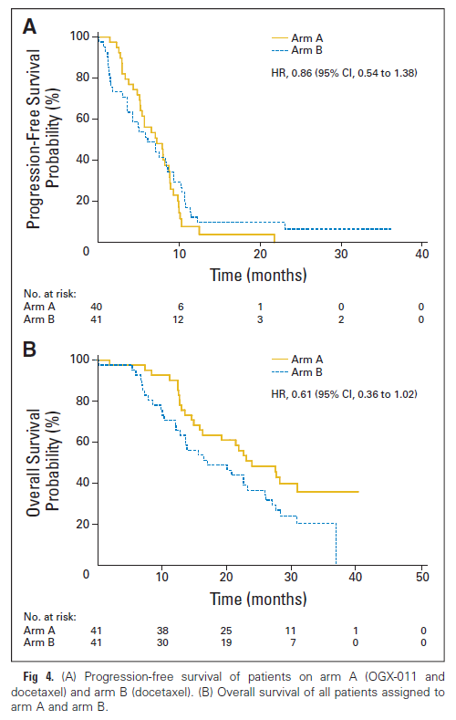
IND.165 Exploratory Results

Slide 38
IND.165 Conclusions
Docetaxel/ prednisone plus OGX 011:
Well tolerated
Predefined protocol criteria for further study met but similar rates of PSA decline and RR in both arms
Evidence of biological effect with decreases in serum clusterin
Trends in PFS and OS are of clinical interest
Exploratory analyses of OS strongly suggest clinical benefit (HR 0.50 95%CI 0.29-0.87)

Slide 39
IND.165
Randomized Phase II Trial
Concurrent control included to anchor interpretation of experimental arm
Experimental arm: H0, HA, error rates predetermined as in a single arm phase II
Subsequent phase III trials failed to demonstrate efficacy

Slide 40
Randomized Phase II Trial Design:
Multiple Experimental Arms (Selection Design)

Slide 41
Selection Design
Simultaneous evaluation of multiple experimental regimens
Prioritization for further evaluation based on antitumour activity, safety, tolerability, compliance

Slide 42
IND.163 Ellard et al J Clin Oncol 2009
EVEROLIMUS in Breast Cancer
(NCT00255788)

Slide 43
Rationale
Breast Cancer
Common, incurable in the advanced disease setting
mTOR (mammalian target of rapamycin)
Involved in cell replication
Mediates the critical PI3K/AKT pathway which is active in breast cancer
Other functions: mediates VEGF, PDGF and TGF
Preclinical inhibitor of mTOR inhibits proliferation
Other mTOR inhibitors active against solid tumours (temsirolimus renal cell carcinoma)

Slide 44
Everolimus in Breast Cancer
Everolimus
Orally bioavailable
Uncertainty about optimal dosing schedule: weekly versus daily

Slide 45
IND.163
Recurrent/ metastatic breast cancer
Strat factors:
Visceral metastases
Prior chemo regimens
R A N DOM I Z E
Everolimus 10 mg po daily for 28 days q4 weeks
RR and early progression*
Everolimus 70 mg po once weekly (day 1, 8, 15, 22) q4 weeks
N < 30 each arm
* Zee B, et al. J Biopharm Stat 1999

Slide 46
IND.163 Objectives
Primary
To evaluate in parallel fashion in each arm:
Anti tumour efficacy based on RR and early PD
Secondary
To evaluate in parallel fashion in each arm:
Adverse event, time to progression and response duration
To correlate RR with molecular markers of mTOR activity
To correlate RR with molecular markers of mTOR activity in fresh tumour samples (consenting patients)

Slide 47
IND.163 Statistical Parameters
No formal comparison between the two arms
H0 response = 0.05 H0 early progression = 0.60
HA response =0.20 HA early progression = 0.40
First stage, enter 15 patients each arm
If 0 responses AND 10 or more early progressions, stop entry into that arm.
If 1 or more responses OR < 10 early progressions, continue that arm and enter 15 more patients.

Slide 48
IND.163 Statistical Parameters
After 30 patients total per arm
If 4 or more responses OR if 13 or fewer early progressions, accept drug as worth further study
Corresponds to type 1 error = 10% power = 93%

Slide 49
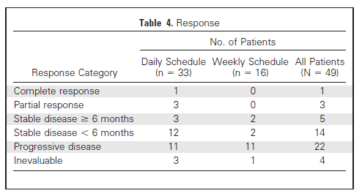
IND.163 Results
Daily Schedule: 4 responses (12%; 95% CI, 3.4% to 28.2%), <13 PD
Weekly Schedule: 0 responses; 11 early progressions end of stage 1

Slide 50
IND.163 Conclusions
Daily dosing of everolimus in minimally pretreated breast cancer patients is active based on predefined study criteria
Data support further testing
Unable to demonstrate any statistical association between response and biomarkers
Subsequent phase III trials demonstrated efficacy of daily dosing schedule

Slide 51
Randomized Phase II Trial Design:
Experimental Arm Compared to Standard of Care (Screening Design)

Slide 52
Screening Design
Non definitive comparison of one or more experimental regimes against the standard of care treatment
Uses an intermediate endpoint such as RR or PFS
Relaxed Type I error rates and targets a promising level of experimental agent activity (i.e. HR)
Not a substitute for a randomized phase III trial

Slide 53
IND.209 EIGL et al, oncotarget 2018
Pelareorep (Reolysin) and Docetaxel in Metastatic Castration Resistant Prostate Cancer
(NCT 01619813)

Slide 54
Rationale
Castration Resistant Prostate Cancer
Second leading cause of cancer death in men
Docetaxel effective but has modest benefit
Pelareorep – Oncolytic virus
Preferentially infect and exhibit cytotoxic effects in human cancer cells
May potentiate anti tumour immune responses
Preclinical data demonstrated activity against prostate cancer cell lines and xenografts
Synergism with taxanes
Phase I trial in combination with docetaxel showed activity and tolerability

Slide 55
IND.209
Metastatic
Castration
Resistant
Prostate Cancer
R A N DOM I Z E
Arm A
Docetaxel 75 mg IV d1
Prednisone 5 mg po bid
Pelareorep 3×10¹⁰ TCID₅₀IV d1-5
Progression Status at 12 weeks
Arm B
Docetaxel 75 mg IV d1
Prednisone 5 mg po bid
N = 80

Slide 56
IND.209 Endpoints
Primary
Lack of Progressive Disease (LPD) at 12 weeks
Secondary
Tolerability and toxicity
Objective Response Rate
PSA change rate
Overall Survival
CTC counts
Prognostic/predictive biomarkers

Slide 57
IND.209 Statistical Parameters
40 patients treated by pelareorep plus docetaxel and prednisone:
H0 12 week Lack of PD (LPD) rate < 30% vs HA 12 week LPD rate > 50%
With a total sample size of 80
90% power to detect difference between arms in 12 week LPD rate from 20 to 50% with two-sided alpha 0.1
58% power to detect a difference between arms in 12-week LPD rate from 30 to 50% with two-sided alpha 0.1

Slide 58
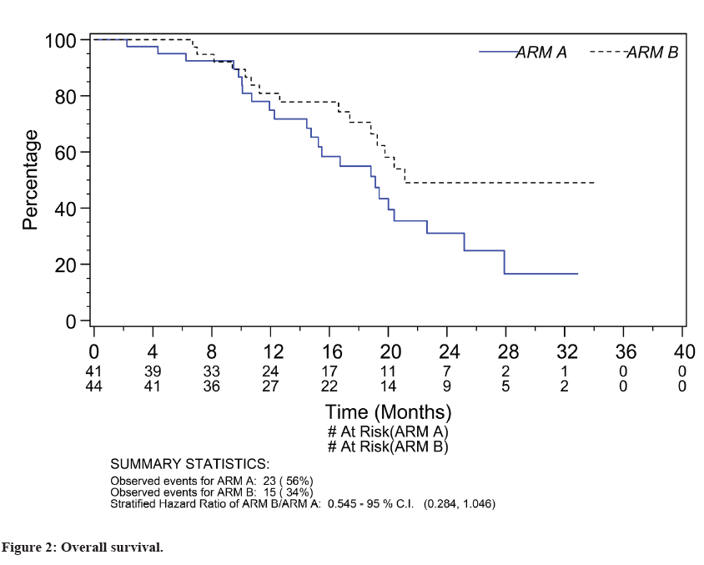
IND.209 Study Results
12-week LPD rate was 61% (Arm A experimental) and 52.4% (Arm B control) p=0.51
Response rates: 26.7% (Arm A) and 40% (Arm B); adjusted OR 0.53; 95% CI 0.12 to 2.38, p=0.41
Overall survival: HR 1.83 (95%CI 0.96-3.52, p=0.06) (no benefit)

Slide 59
IND.209 Conclusion
Combination of pelareorep with docetaxel was tolerable with comparable LPD in both arms but response and survival were inferior and so this combination does not merit further study

Slide 60
Can we improve the efficiency of the randomized, comparative phase II (Screening) design

Slide 61
Randomized Phase II/III Trial Design

Slide 62
Br.18 Douillard et al, LUNG CAn 2004 leighl et al, J Clin Oncol 2005
A PHASE II/III DOUBLE BLIND RANDOMIZED TRIAL OF BMS-27529l VS. PLACEBO IN PATIENTS RECEIVING PACLITAXEL/CARBOPLATIN CHEMOTHERAPY FOR THE TREATMENT OF ADVANCED OR METASTATIC NON-SMALL CELL LUNG CANCER
(NCT 00006229)

Slide 63
Rationale
Advanced/ metastatic non small cell lung cancer
Leading cause of cancer death in men
Platinum based chemotherapy – a treatment option
BMS 275271
Orally bioavailable inhibitor of matrix metalloproteinases which appear to be important in tumour growth and spread
Preclinical data demonstrated antiproliferative activity in several animal models
May improve outcomes when combined with chemotherapy

Slide 64
BR.18
Stage IIIB/IV NSCLC
Strat factors:
Stage IIIB vs IV
ECOG 0,1 vs 2
R A N DOM I Z E
Arm A
BMS275271 daily
+ paclitaxel/carboplatin q21 days
Survival
Arm B
Placebo
+ paclitaxel/carboplatin q21 days

Slide 65
BR.18 Phase II Trial Objectives
To evaluate the incidence of grade 2 or higher drug related arthritis, arthralgia and/or myalgia in each arm
To estimate the objective tumour response rate in each arm
To evaluate the nature, severity, and frequency of toxicities

Slide 66
BR.18 Phase III Trial Endpoint
Primary
Overall survival (OS)
Secondary
Progression-Free Survival
Response Rates/ Time to Response, Response Duration
Toxicities
Quality of Life/ Economics
Biological Correlatives – correlation of tissue MMP, circulating MMPs with outcomes

Slide 67
BR.18 Trial Statistical Parameters
Phase II
With a total sample size of 30 each arm
Ha > 20%: > 2 responses in the experimental arm
AND
incidence of grade 2 or greater drug related arthritis, arthralgia and/or myalgia, a lower limit of the 95% confidence interval less than 50%

Slide 68
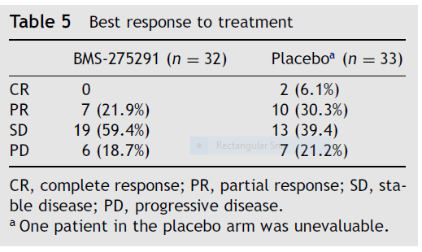
BR.18 Trial Phase II Results
Toxicity
Grade > 2 drug related toxicities of interest
BMS-275291: 31.5%, lower limit 95% CI = 17.6%
Response Rates

Slide 69
BR.18 Trial Phase III Efficacy Results
HR 1.09 (0.93-1.28) P=0.30

Slide 70
BR.18 Trial Phase III Results: Toxicity

Slide 71
BR.18 Trial Conclusion
BMS 275291 does not add to the treatment of advanced NSCLC.

Slide 72
Variations of Phase II Trial Methodology: Platform Trials (more to come!)

Slide 73
Phase II Design: PROs and CONs
Randomization | Design | PROs | CONs
Single arm¹ | Single arm design; two stage design. | Simple, efficient and easy to implement. Useful in rare diseases and signal detection. | Lack of control data
Randomization including control arm with no formal comparison | Noncomparative randomized design (like 2 parallel single arm designs) | Contemporaneous control allows meaningful interpretation of experimental arm. Sample size still moderate. | Larger sample size comparing with single arm study; no formal statistical comparison.
Randomization to experimental arms only | Screening/selection design | Allow exploration of multiple treatments (dosage, combination, etc.). Efficient use of resources. | Lack of control data
Randomization including control arm with formal comparison | Randomized control trial | Robust evidence. Minimizes bias. Regulatory acceptance. | Large sample size; long trial duration; complexity and cost.
Includes platform design where patients were assigned to each cohort/substudies based on biomarker since each cohort can be viewed as a single arm study.

Slide 74
Learning Objectives
√ To define the role of a phase II trial in oncology drug development
√To describe the objectives and the statistical parameters that provide the framework of a phase II trial design
√ To illustrate different phase II trial designs using examples from the CCTG casebook

Slide 75
Thank You

Slide 76
References
Buckstein R et al. Leukemia & Lymphoma, 2011; 52(5): 833–41
Chi KN et al. J Clin Oncol. 2010; 28(27): 4247-54
Chi KN et al. Lancet Oncol. 2017; 18: 473-85
Beer TM et al. Lancet Oncol. 2017; 18(11): 1532-42
Ellard SL et al. J Clin Oncol. 2009; 27(27): 4536-41
Baselga J et al. N Engl J Med. 2012; 366: 520-9
Zee B et al. J Biopharm Stat. 1999; 9(2):351-63
Eigl BJ et al. Oncotarget 2018;9(8):8155-64
Douillard et al. Lung Cancer 2004;46(3):361-8
Leighl NB et al. J Clin Oncol. 2005;23(12):2831-39
Review articles
Rubinstein L et al. Clin Cancer Res. 2009;15(6): 1883-90
Mandrekar S et al. J Thorac Oncol. 2010;5: 932–934
Seymour L et al. Clin Cancer Res. 2010; 16(6): 1764-9

